Slide 1
Digital transformation at Argonne national laboratory
March 2020
erhtjhtyhy
JASON Partyka
Bec white
Argonne National Laboratory
Palantir.net
November 14, 2019

Slide 2
Hello!
We've been working at and with Argonne National Laboratory over the past 4 years to transform the lab's public and internal web presence.
Notes:
Introductions & Roles
We're technical folks, but today we're going to take a half step out of our lane to talk about how some technical and project decisions impact the larger organization.
Introductions
1) Bec
2) Jason

Slide 3
Notes:
Jason
Screenshot:
APS – Advanced Photon Source

Slide 4

One of the Department of Energy's 17 National Laboratories
Located in the Chicago Suburb of Lemont, IL
Surrounded by the Waterfall Glen Forest Preserve
13,000 people
16 research divisions
https://www.anl.gov/research-index
5 National Scientific User Facilities
Notes:
Jason
Taken verbatim from Argonne's d.o page:
Argonne is a multidisciplinary science and engineering research center, where “dream teams” of world-class researchers work alongside experts from industry, academia and other government laboratories to address vital national challenges in clean energy, environment, technology and national security.
Appx 13,000 people have a reason to be on campus
Home to the APS, which is doing research on coronavirus – articles on ABC7, ChiTrib, etc.

Slide 5
Palantir...
Web consultancy
Working with Argonne since 2015
Notes:
Bec

Slide 6
The BIS division manages a host of digital services
Internal and external communications
HR, benefits, and training
Ticketing and access to services from conference planning to electrical inspections
Document management for policy & procedures, research & publications
Notes:
Jason
https://search.creativecommons.org/photos/8fc63ef5-bcb4-40af-8a7d-65adb50ff2fe
BIS = Business & Information Services. Jason is part of this division. Collaborates with Communications & Public Affairs to provide communications platforms.
-- Jason

Slide 7
... with a lot of constraints
Security requirements for how much access each of the 10,000 staff and collaborators have to each system
Contracting, location, and compliance requirements for any software used
Long application lifetimes
Information or services managed by other departments
Notes:
Jason
Because of the size and scope of the organization (and it being a gov organization), we have some very specific constraints on our technology use, like:
* Security – content publishers require elevated authentication to publish
* Records retention – rules around retaining content published in a "broadcast medium"
* Interdepartmental coordination – taxonomy is managed by the library department, and wasn't designed for use with web content (but we still have to use it)
* Privacy – what employee information is being used from HR systems?
* Application lifetime – the intranet was over 12 years old, the document management system over 11 years old

Slide 8
Let's talk about the services that use Drupal (and some WordPress)
Drupal is used for both external and internal communications platforms, meaning the public websites and the intranet.
Notes:
Bec
* Multiple audiences
13,000 staff, collaborators, and contractors, so our internal audience is a significant part of the communications strategy

Slide 9
March 2017
Began development on the web project
Planned launch in September 2017
Included public site (www.anl.gov), the intranet site, content syndication between the two, and integration with internal systems from authentication to researcher profiles to publication management
New technology stack expected to be in use for the next 5-10 years
Notes:
Bec
The project was planned to accomplish every desired feature:
* public website
* redesign
* single sign on, managing user accounts *and permissions* outside of Drupal
* integrate with scientific publications management system
* researcher profiles based on internal person and role data
* integrate with internal taxonomy system
* replace Drupal 6 based intranet
* single sign on
* integrate with ticketing system
* integrate with HR, benefits, and training systems
* syndicate news & events from the intranet to the public website
The development was organized into sprints, but the scope was set at the beginning of the project – everything was on the table.

Slide 10
August 2018
Relaunched www.anl.gov
Launched 11 months later than original timeline
... with about 60% of the original scope
Public site only
No intranet
No content syndication
Notes:
Bec

Slide 11
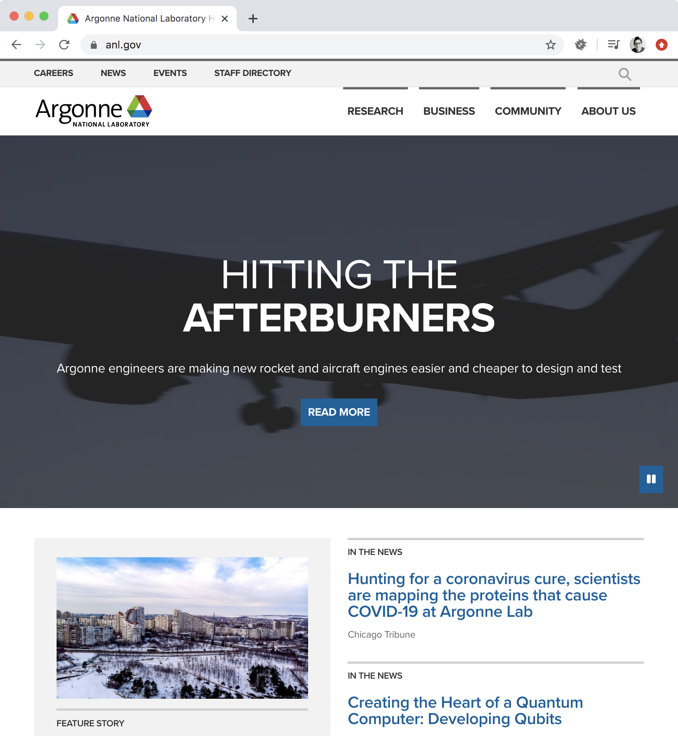
site launch
www.anl.gov
Beautiful new design
Authentication and data integrations with other systems
Robust testing
Included reusable platform for future work
Notes:
Bec

Slide 12
However there were a few challenges!
Notes:
Bec

Slide 13
Challenge 1:
Launch cliff
What happens to the other 40% of the planned functionality?
Now we maintain this...
Notes:
Bec

Slide 14
Challenge 2:
Daily complexity for content managers and end users
Since we launched without the intranet, content managers were adding news and events in 2 locations (public site and separate, preexisting internal news site)
Host of digital services are still there
User feedback was: "Nice site, but I'm frustrated with X"
Notes:
Bec

Slide 15
Challenge 3:
Expanded timeline + reduced scope
Planned a 6 month project, turned into an 17 month project
Original feature set didn't survive the process
Notes:
Bec
Pivot from original goals

Slide 16
our latest project, the intranet site
May 2019 – December 2019
Planned a 6 month project, completed in 8 months
95% of original feature set
Focus on reducing complexity for users
User feedback was: "This is awesome"
Notes:
Bec
Removed VPN requirement for users to access intranet information (great, because all of the current WFH is maxing out the VPN)
Replaced one site entirely – old News & Events WordPress site, "ArgonneToday"
Paved the way to replace the old intranet (manual content migration is in progress)

Slide 17
How did we do that?
Built a well-tested web platform (www.anl.gov launch)
Integrated with internal systems
Created a feedback cycles and transparency with lowercase "a" agile
Notes:
Bec
Laid the foundation for this in our first project – the first project took longer, but it included testing and reusable integrations that provided the basis for the intranet project

Slide 18
How building a platform transformed the web at Argonne National Laboratory
Notes:
Jason

Slide 19
How building a platform transformed our web work
CI testing maintains stability
Shared code expands technical capacity -- able to take on more complex and highly integrated projects
Notes:
Jason

Slide 20
CI/CD Continuous integration/delivery
What is CI/CD?
In software engineering, continuous integration (CI) is the practice of merging all developers' working copies to a shared mainline several times a day
https://martinfowler.com/articles/continuousIntegration.html via https://en.wikipedia.org/wiki/Continuous_integration
Continuous delivery (CD or CDE) is a software engineering approach in which teams produce software in short cycles, ensuring that the software can be reliably released at any time and, when releasing the software, doing so manually.^{[1][2]} It aims at building, testing, and releasing software with greater speed and frequency. The approach helps reduce the cost, time, and risk of delivering changes by allowing for more incremental updates to applications in production. A straightforward and repeatable deployment process is important for continuous delivery
https://en.wikipedia.org/wiki/Continuous_delivery
Notes:
* Apps includes websites!
* We just turned off CVS
* Document Management has been around for 11 years

Slide 21
CI/CD
Brand new to Argonne's IT department
Space Shuttle to Warp (but not > c)
CircleCI
GitLab
TravisCI
Notes:
Very few tools were in place
Management saw value --- but not widely socialized

Slide 22
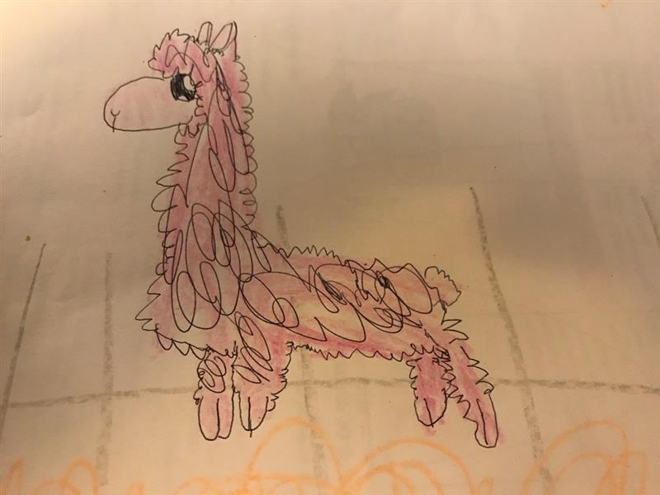
CI/CD Continuous integration/delivery
Why did we feel this was necessary?
Developers come and go.
Not everyone knows a lot about Drupal!
Some developers have been developing since the 80s!
Slower moving environment.
Notes:
* Apps includes websites!
* We just turned off CVS
* Document Management has been around for 11 years
---
*-----------
Llama llama no drama
--
Developers come and go.
Not everyone knows a lot about Drupal!
Some developers have been developing since the 80s!
Some are used to businesses with more "concrete" requirements and workflows
Slower moving environment
Regulations
Policies and procedures

Slide 23
CI/CD Continuous integration/delivery
Started from almost-zero
Big assist from Palantir
Move into git
Established a build process
Established a real, but limited testing framework
Notes:
Almost zero:
* Running Jenkins internally in a 'shadow'-IT sort of way.
--- this made it difficult to stay up to date—App/OS/you name it
* Never used it much beyond a super-cron/script runner
* Disconnected from SVN
---- even though it deployed code, our scripts were not part of the repo.
---
Big assist from Palantir
--- build process:
- https://github.com/palantirnet/the-build

Slide 24
CI/CD Continuous integration/delivery
What did we start with?
Code reviews
Does the site install?
Behat
Notes:
"does the site install" == a smoke test
-- We only had the capability to test basic text input
--- bought us much more than we could ever have hoped for
--- EXCELLENT at testing integrations
BUT:
--- not really suited for unit tests

Slide 25
CI/CD Continuous integration/delivery
What do we have now?
Three websites, one code base.
Completely different business cases!
Behat test are:
~ 550 scenarios
~ 8000 testing steps
Testing "clean" installs *and* production updates.
Notes:
What do we have now?
---
Added a new site – the Guesthouse
----
Although diff. Business cases, share many of the same content types.
Makes it easy for the content-editors
---
* Production update tests help to give us early warning if there's a problem applying the update.
* You never know when they're going to happen!
* Incredibly useful on a team with newbies!
First major win:
https://www.drupal.org/sa-core-2019-003
--- Metatags are used as part of our integration with our Enterprise search (Coveo)
------- Integration just rolled out due to on-prem GSA retiring
------- Ended up using a bug as a feature, and when the bug was fixed, our integration broke.
------- Fixed the feature that's now a bug, tests worked again, and we were on our way!
-- Testing process supported a changing our search provider

Slide 26
CI/CD Continuous integration/delivery
First major "win":
https://www.drupal.org/sa-core-2019-003
Metatag module update
Would have been really bad if we didn't catch before prod deploy.
Notes:
Metatags:
* Drive our integration between Drupal and Coveo
* We inadvertantly ended up using a bug as feature
* When applied the update it broke
* But we were able to fix within a couple of hours

Slide 27
CI/CD Continuous integration/delivery
What did this buy us?
Confidence
Apply Updates to multiple sites
Ease the testing burden.
Set an example.
Notes:
* Everyone on the team recognizing testing is important
* Problem that we have now:
--- Testing is hidden
--- Problems are solved before they get to end-user/customer (most of the time)
* Examples
---- For the rest of BIS

Slide 28
How an integrations approach transformed the intranet experience

Slide 29
How an integrations approach transformed the intranet experience
Reduce user complexity, increase technical complexity
Users interact with many systems for key daily tasks
Integrate with systems to provide frequently used and critical information in one place
Vacation, sick, and holiday time
Required trainings
News, events, and director's messages
Document management system search
Staff directory
Notes:
Bec -
By integrating these systems with the intranet, we can shift complexity from users to the technology
In most cases, we didn't replace those separate systems -- just pulled the key information in for viewing, and provide pathways out
--> HR system, training system -- they do many things the intranet doesn't
This is an ongoing consideration in how we prioritize new intranet features
This project is part of a larger initiative, "Improving How We Work"

Slide 30
Integrations
AuthN and AuthZ
Person Information
PTO, Training
Network Status
Notes:
Jason
Authentication = you are who you say you are
Authorization = what level of access you have
* Implemented in a reusable manner
--- integrations are treated as a dependency managed by composer
--- Not just directly consuming an endpoint with CURL
* Treated the integrations as their own deliverable, and that was then used to create the user-facing concepts.
How do we as technologists support organizational change / "digital transformation"

Slide 31
Integrations
Single Sign On
More than just "who are you"
Focal point for personalization
Notes:
Authentication = you are who you say you are
Authorization = what level of access you have
* Basic AuthN/AuthZ integration for www.
--- control who can edit what
** Laid the foundation for all of the personalization for My Argonne

Slide 32
Integrations
Person Information
Migrate, not web service call
Provides metadata to our search provider
Helps to provide researchers with their own editable profiles
https://www.anl.gov/argonne-researchers
Notes:
* Data is used so heavily within Drupal
* Used everywhere to help populate:
--- search data
--- biographical info for profiles
--- personalized content
* same integration is used on both sites
* Is important to each division that their entire staff is automatically represented, but up to division/researchers on editing.

Slide 33
Integrations
PTO & Network Status
PTO, Training
Put the most commonly used information in an easy location
Network status
Some services are VPN only
Notes:
PTO – integration with HR system. Make it easy for users to find decision-related info.
When people need to gather information from multiple systems to complete a task, they're less likely to complete it correctly. So, put the information in one place – but we're not replacing the HR system! Just putting the most commonly used information in an accessible location, and then linking out.
Network status – some access changes when you're on the Argonne network (either physically or VPN)
* access to Drupal admin areas
* some applications/systems are VPN only – cue users that they need to use to the VPN

Slide 34
How agile transformed the way we work

Slide 35
How agile transformed the way we work...
(lowercase"a" agile)
Phased approach improved time to launch and allowed safely deferring blocked features
Change management increased feedback and eased adoption
Full team participation increased accuracy of features
Notes:
Included full team in definition and development process

Slide 36
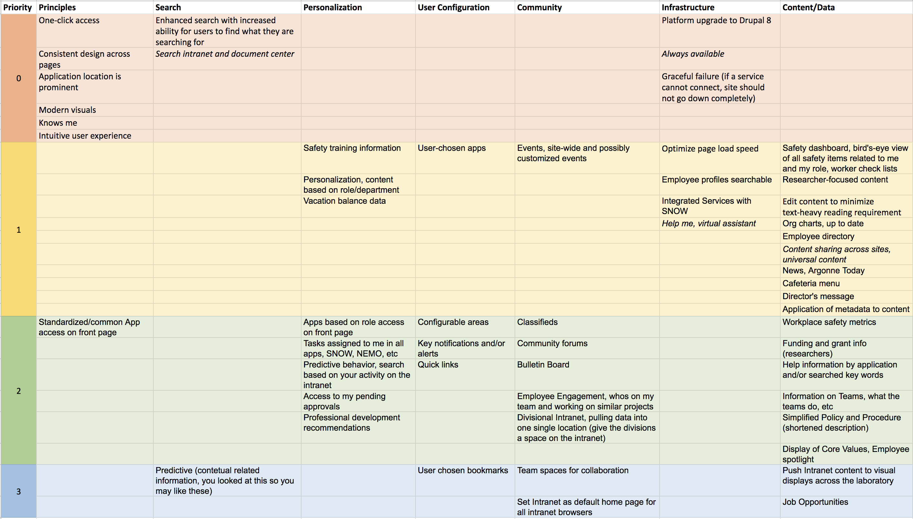
Notes:
We started with a scope grid
Red = fundamentals
Yellow = rollout 1
Green = rollout 3

Slide 37
Phased approach
December 2019 launch was "rollout 1"
Included features that:
Used existing APIs and data
Reduce systems complexity where possible
Improve user experience across applications
Unblock content work
Postponed features that:
Integrate with systems waiting for upgrade
Depend on broad user participation/buy in
Duplicate functionality in other software
Notes:
Reused code for SSO, profile integrations from public site launch
Changes to existing internal APIs were limited to adding a few data points (e.g. we needed the "job role" of users)
Removed VPN requirement for users to access intranet information (great, because all of the current WFH is maxing out the VPN)
Replaced one site entirely – old News & Events WordPress site, "ArgonneToday"
Paved the way to replace the old intranet (manual content migration is in progress)
Short term roadmap also includes replacing:
* an email newsletter
* a standalone staff directory application
* deprecate most users' access to editorial functionality on the public website (profile management)

Slide 38
When should you Prioritize or defer a feature?
Balancing opportunities and dependencies in each rollout
Integration with other systems or departments
User impact
Technical risk
Notes:
Biggest thing is – if another system or group isn't ready, it will delay our project
* technology is in transition – we're planning to replace a system, but haven't started yet
--> this WILL delay the integration!
* technology is in development -- developers are working on the API, but we can't consume it yet
--> could delay if not ready. Coordinate during phase 1, adopt in phase 2
* people aren't ready – skepticism and lack of confidence about new systems; investment in existing ways
--> earlier phases can establish confidence and buy in
* people need training
--> earlier phases can provide functionality to train on, but content promises come later!

Slide 39
Breaking down the work
Turning features into actionable pieces – User Stories
Workshops for each feature
Gather information from the full team about the boundaries
What does everyone agree on?
What's definitely excluded?
Identify the smallest possible number of critical stories
Notes:
"MVP"
The smaller the MVP, the more flexibility you have to determine priorities
Bucket of cold water -- "if you could only have one part of this feature, what would it be?"

Slide 40
Change Management
Key to smooth adoption
Kept end users informed with regular updates
Clear messaging from product owner about features and timeline
Notes:
There was a point person at Argonne – Angela Kenyatta – who coordinated communication with end users and stakeholders
Town halls for communication

Slide 41
Full team participation
Inclusive decision making
Feature definition includes:
Product owner
Designer
Developers
Content manager
Work as peers to understand the system end-to-end
Feedback early and often:
During definition
After each sprint
After each deployment
Notes:
Include specialists where needed
When we can understand both the technical constraints and the content needs, we can describe the feature correctly the first time
We want to get feedback as early as possible. Getting content managers – the most thorough, informed, and empowered users of your system – into the site as early as possible yields the most valuable feedback on how the site will work in practice.

Slide 42
So, if you're asking us how to do this...

Slide 43
Our key approaches
Include a test suite from the beginning
Write reusable code
Build and consume internal APIs
Plan work in phases, and allow/expect future phases to shift
Get feedback and visibility early and often
Notes:
Psychological safety in shifting blocked work out to the next phase – because there's a plan/timeline for the next phase

Slide 44
Hints you're doing it right
If your applications have a long lifecycle, you have automated testing
... and your tests fail sometimes
You have a custom module to integrate with an internal system
... and it's used on more than one site
If your project features have extensive dependencies on other software and teams, you have a phased plan focused on "what's the most impactful thing that is unblocked right now?"
... and there are "critical" features in phase 2 if they have a different timeline than your project

Slide 45
Hints you're doing it right
(continued)
You have a content manager involved in your feature definition and sprint reviews
... and the product owner and developers are asking for information
You get feedback on your work from each sprint
... and some of it is critical
Technical leadership talks about automation
… and funds it

Slide 46
Thanks!

Slide 47
Feedback:
Contribution day
https://mid.camp/6302
Saturday, March 21, 2020
More information at https://www.midcamp.org/2020/contribution-day

